Slide 1


KS1 Meet the Teacher Evening
Wednesday 10th September 2025
5-5:30pm

Slide 2
Key Stage One Classes
Door Duty
Mon – Miss Zak Tue – Mrs Birthwistle Wed – Miss Markham Thu – Mrs Bolton Fri – Miss Wilkinson
Holly Class | Horse Chestnut Class | Pine Class
Miss Zak Miss DeRosa (Wednesday morning) | Miss Markham Mrs Govender (All day Thursday & Friday morning) | Mrs Kennerley Mrs Mercer (Monday afternoon)
Mrs Birthwistle Mrs Varo-Clement | Mrs Bolton Mrs Hind Mrs Sharples Miss Hill | Miss Wilkinson Mrs Sharples Miss Hill
Miss Palmieri also teaches Computing for each class. Holly (Thursday mornings) Horse Chestnut (Thursday afternoons) Pine (Tuesday afternoons)

Slide 3

Communication
Autumn | Spring | Summer
Parents’ Evening Short Report | Parents’ Evening Short Report | Long Report
Ongoing
Owl Board Topic Newsletter School Website Parent Pay Pick Up & Drop Off
CLASS EMAILS ARE TO BE USED FOR SHARING LEARNING. ANY URGENT MESSAGES SHOULD BE ADDRESSED VIA THE OFFICE OR ON DROP OFF / PICK UP. THEY ARE NOT ALWAYS SEEN ON THE SAME DAY.

Slide 4
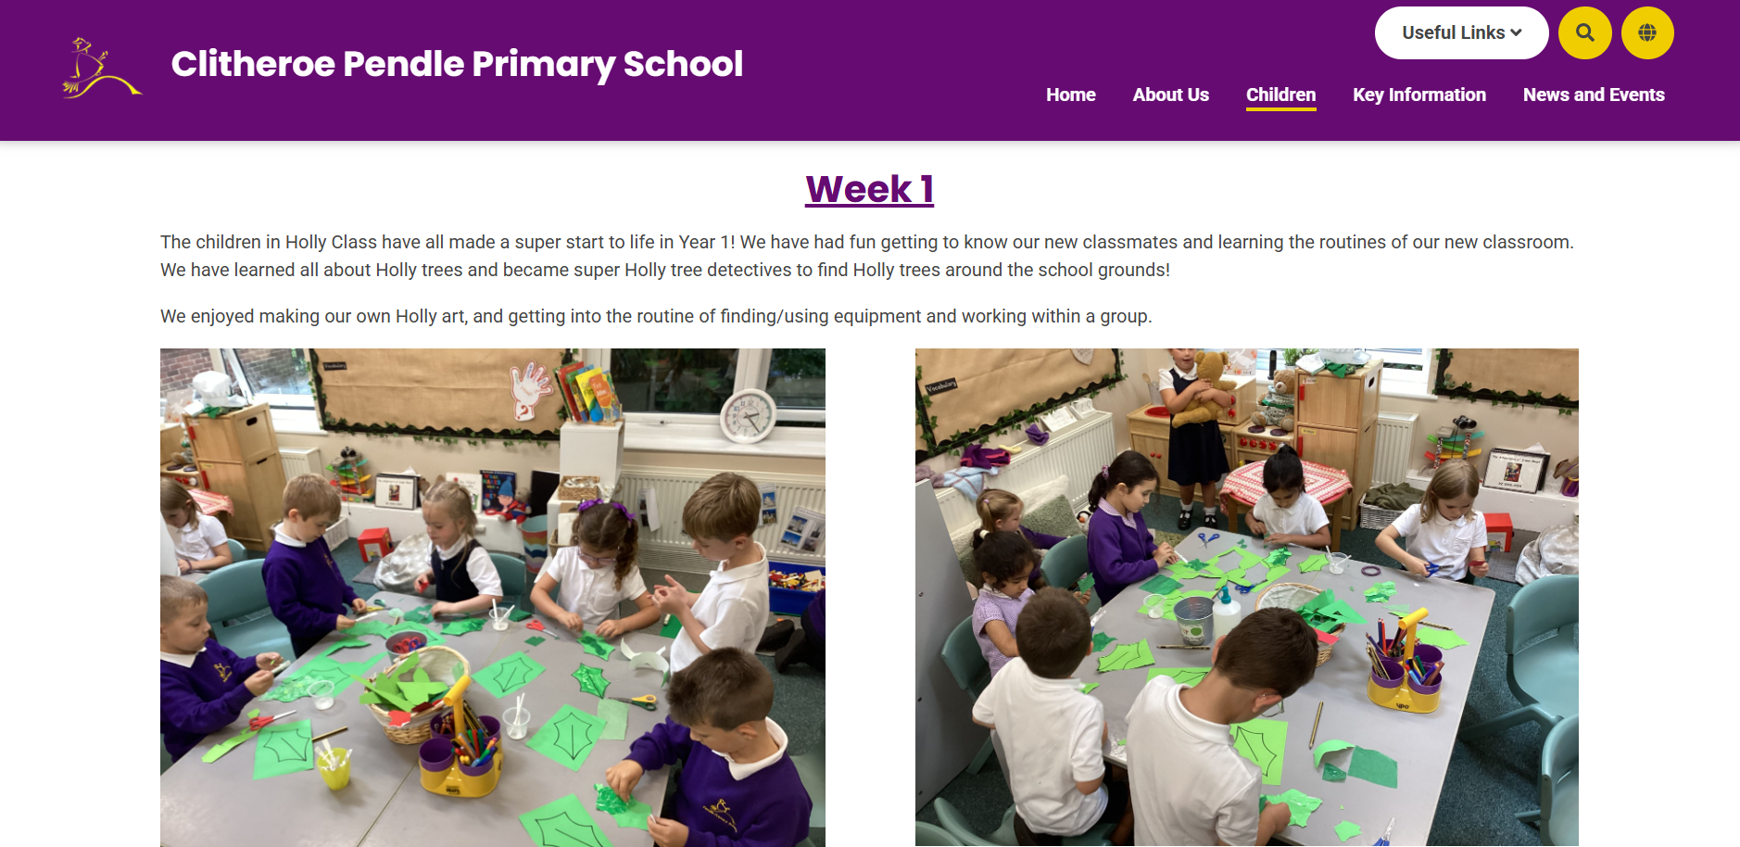
New Website
Children -> Class Pages
Blog Style Updates

Slide 5
DSL
In school, we are fortunate to have 5 ‘Designated Safeguarding Leaders’
Mrs Nunns
Mrs Mercer
Mr Morris
Mrs Schofield
Miss Markham

Slide 6
Governors
At Pendle, we are very privileged to have a very talented group of governors, with skills in many areas.
Mr David Walton is our Chair of Governors.

Slide 7
Online Safety
https://swgfl.org.uk/resources/online-safety-guidance-for parents/?gad_source=1&gclid=EAIaIQobChMIjfzho5S0iAMVtZhQBh3KojbMEAMYAiAAEgKBjvD_BwE
At Pendle, we take this area of the curriculum very seriously as we have a duty to teach our children to be safe users of technology and the internet. Our children are taught to stay safe online through their weekly Computing sessions and the PSHE curriculum.
Out of school there are a number of websites you, as parents and carers, can use for information and advice.
Please be aware the content on these sites is sensitive and adult led. Further information and other leaflets are available in school should you wish to know more.
Thank you
Mrs Schofield
https://www.childnet.com/help-and-advice/parents-and-carers
https://saferinternet.org.uk/guide-and-resource/parents-and-carers
https://www.nspcc.org.uk/keeping-children-safe/online-safety/?gclsrc=aw.ds&gad_source=1&gclid=EAIaIQobChMIjfzho5S0iAMVtZhQBh3KojbMEAAYAyAAEgJcdPD_BwE&gclsrc=aw.ds
https://www.ceopeducation.co.uk/parents/

Slide 8

Curriculum
Our curriculum has been carefully planned to ensure a diverse, enriched and exciting learning journey for the children as they progress through school. We take our learning outdoors and out of the school grounds as much as possible!
History, Geography, Art and DT are taught on alternate weeks across a full term. PE, Science, Music, PRSHE units change each term.
Maths, English, Phonics, Guided Reading are taught daily.
Handwriting and NCETM (Mastering Number) are taught 3 times a week.

Slide 9
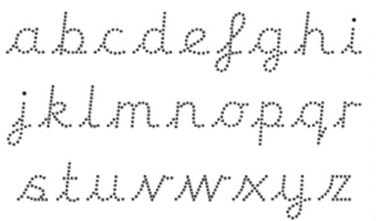
Handwriting
We follow the cursive letter formation. We will begin learning this in Year 1. If your child is practicing their cursive writing at home, please ensure they are leading into the letters rather than forming the letter and then adding the lead in.

Slide 10



Year 1 Phonics Screening Check

Slide 11
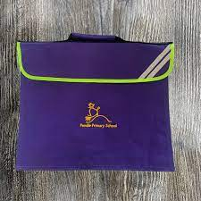

Reading, Reading, Reading!
& Phonics homework

Slide 12
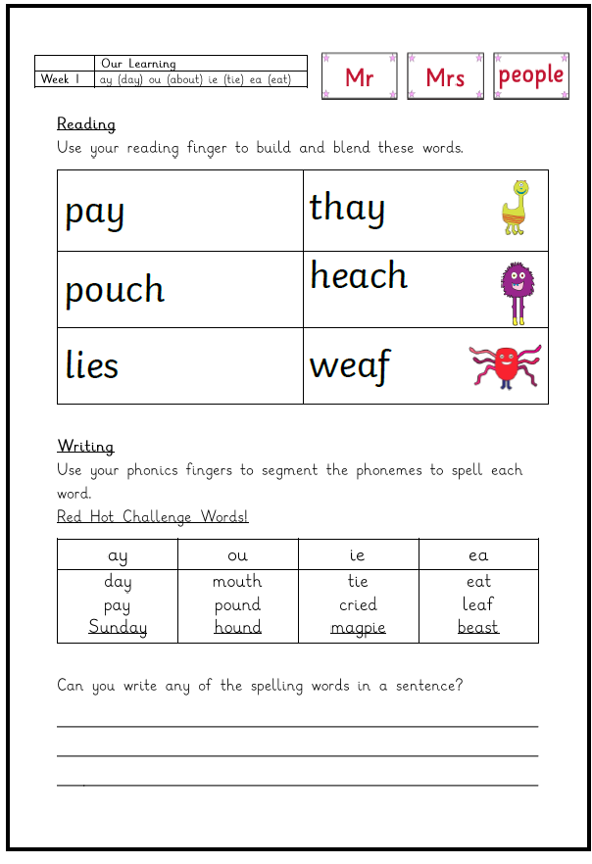
Phonics Homework

Slide 13
Assessment
Live Marking & Daily Observations | Assessment for Learning Sheet | Reports with Tracker Rocket
Phonics Screening | Phonics Tracker | Maths.co.uk

Slide 14
Homework
Book Bags Home Daily | Reading Books (All children will be listened to by an adult within Guided Reading sessions x2 a week) | Library Books
Numbots | Homework Project linked to topics | Phonics (For Year 1)

Slide 15
Behaviour
We have high expectations for children’s behaviour in class, around school and when taking part in visits.
Everybody at Pendle has a right:
To be safe
To fair treatment
To be heard
To be treated with respect
To learn and teach without unnecessary interruption
Our door is always open should you have any behaviour concerns. Again, teamwork makes the dream work!

Slide 16
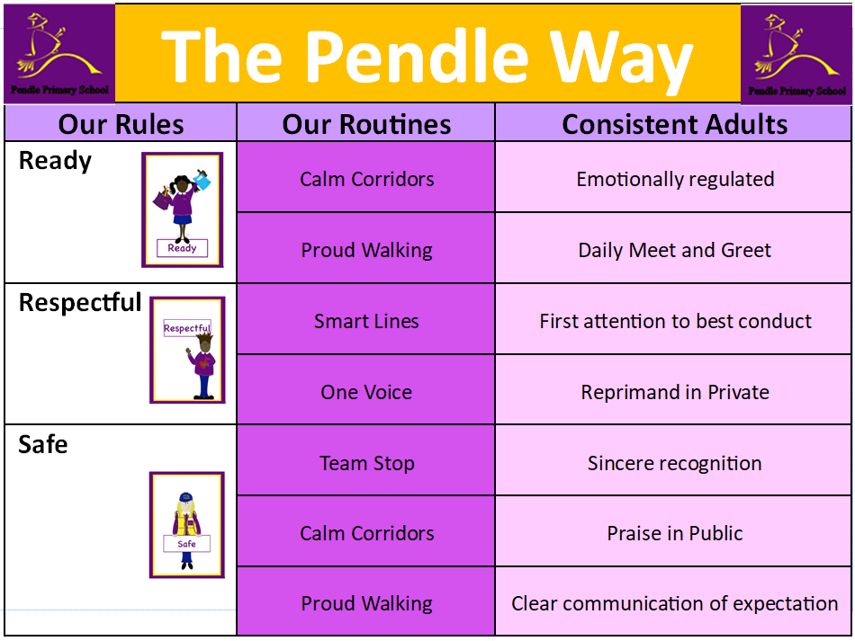

Slide 17
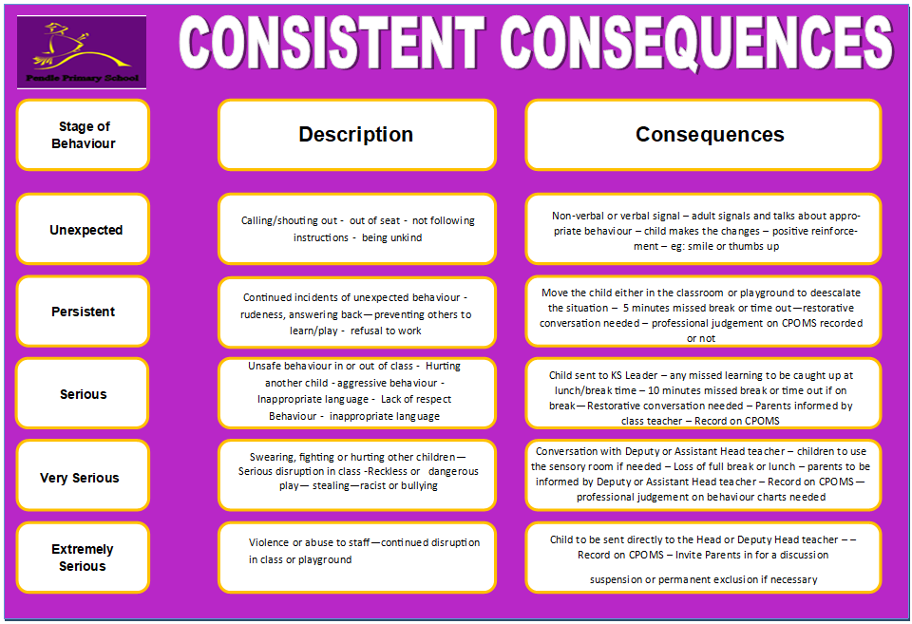

Slide 18
Mental Health and PRSHE
PRSHE Curriculum
Assemblies
Theme days (Anti-bullying week etc).
RHE policy on website (Relationship and Health Education)
Counselling service

Slide 19
Rewards!
Praise | Raffle tickets | Certificates
Praise Postcards | Celebration Assemblies | Thank you Thursdays
Stickers and stamps | Team points | Class Bear
All classes have a class recognition board with identified behaviour targets that the whole class works towards. This encourages a team spirit and supporting each other to reach our behaviour goals.

Slide 20
Uniform Reminders
Please make sure that ALL uniform is clearly named. (Please!)
No jewellery including earrings.
Hair tied up. (Simple headbands)
No nail varnish.

Slide 21
Organisation Reminders
Children need to bring water bottles to school each day as part of promoting a healthy and active lifestyle.
Your child will receive a piece of fruit each day so you do not need to provide your child with any.
Please do not allow your child to bring a toy to school as the children are provided with equipment and activities to occupy them at playtimes.
Please ensure that your child has a FULL, named PE kit in school for each half term. The outdoor PE kit is in addition not instead of the indoor PE kit.

Slide 22
Thank You for your support!

