Slide 1

2018-2019
LKS2 2025

Slide 2

Our Team
Mrs Schofield
Mr Taylor
Miss Ridgway
Mr Morris
Mrs Wardle
Miss Palmieri (Computing)

Slide 3
Home /School
Please limit the number of items that are travelling to and from school. With this in mind…
Children should only bring their reading book and bag, lunch box, fruit snack and water bottle to school.
PE kits should be kept in school.
Please don’t allow your child to bring any toys, balls or items for show and tell etc.
Please do not send in anything to share with others in class such as birthday cakes due to allergy issues.

Slide 4

General Communication Information
You are always welcome to discuss any concerns you may have.
Feel free to ring the school office to book an appointment or catch us at the start/end of the day.
01200 423535

Slide 5
Regular Communication and Information
Please keep up to date on our learning though the following:
Parent Pay
Newsletters
Website
Topic Letters

Slide 6

DSL
In school, we are fortunate to have 5 ‘Designated Safeguarding Leaders’:
Mrs Wendy Nunns
Mr Morris (SENCO)
Mrs Schofield
Miss Markham
Mrs Mercer
We are always ready to offer support, help and advice.

Slide 7

Our Governors
At Pendle, we are very privileged to have a very talented group of governors, with skills in many areas.
Mr David Walton is the Chair of Governors.

Slide 8

Our Curriculum
In class we aim to stretch, challenge and enhance children’s learning through a range of stimulating and creative learning opportunities.

Slide 9
Our Curriculum
Maths and English are taught daily. Science is delivered for 2 hours a week, whilst the foundation subjects occupy the remainder of the week.
Year group expectations can be found on the website.

Slide 10
Our Curriculum
At Pendle, we understand the need for a healthy and active lifestyle and P.E. sessions take place weekly both in school and later in the year at Roefield.
For the first time, Year 3 and Year 4 will be swimming this year. Your child will need a sensible swimming costume, a towel and goggles (if wished) for these sessions.

Slide 11

Using a pen
Once your child is a confident writer using the cursive script, they can write with a handwriting pen.
All the children edit and improve their work with a purple pen, during and after marking.

Slide 12
Homework
Reading books are to be taken home daily and returned the following morning.
Children are responsible for their books and once completed, they are encouraged to ask for a new one. New books are recorded and highlighted to show coverage.
We set a half termly homework challenge for all pupils. Details can be found on our class page.
TT Rock Stars homework is set weekly. Please ensure that your child completes their game allocation on time.
Your child will need to know their username and password for TT as we will be logging on in class regularly too.
Spelling patterns can be found weekly on the website. Please encourage your child to learn the spelling patterns. There will not be a spelling test in school.
Children are expected to record in their homework diaries daily and parents are required to sign weekly.

Slide 13
Times Tables
Year 4 pupils will be formally tested on their multiplication skills at the end of the school year.
Year group expectations are:
Year 3: x2, x3, x4, x5, x8, x10
Year 4: ALL times tables up to 12x12
Websites to consider apart from TT -
https://www.bbc.co.uk/sport/supermovers/42612499
https://www.topmarks.co.uk/maths-games/daily10

Slide 14
Uniform
Please note the following:
Children with shoulder length hair should have it tied up at all times.
Children should not be wearing any jewellery or earrings.
Children should wear sensible school shoes, not black trainers.
Children should have all of their uniform labelled.

Slide 15
Behaviour
Once again we have high expectations for children’s behaviour in class, around school and when taking part in visits.
We take behaviour seriously at school.
Everybody at Pendle has a right:
To be safe
To fair treatment
To be heard
To be treated with respect
To learn and teach without unnecessary interruption
Full details of our Behaviour Policy can be found on the website.

Slide 16



Behaviour
We would like our pupils to be ready, respectful and safe at all times.

Slide 17
Online Safety 2025
At Pendle, we take this area of the curriculum very seriously as we have a duty to teach our children to be safe users of technology and the internet. Our children are taught to stay safe online through their weekly Computing sessions and the PSHE curriculum.
Out of school there are a number of websites you, as parents and carers, can use for information and advice:
https://swgfl.org.uk/resources/online-safety-guidance-for-parents/?gad_source=1&gclid=EAIaIQobChMIjfzho5S0iAMVtZhQBh3KojbMEAMYAiAAEgKBjvD_BwE
https://www.childnet.com/help-and-advice/parents-and-carers
https://www.nspcc.org.uk/keeping-children-safe/online-safety/?gclsrc=aw.ds&gad_source=1&gclid=EAIaIQobChMIjfzho5S0iAMVtZhQBh3KojbMEAAYAyAAEgJcdPD_BwE&gclsrc=aw.ds
https://saferinternet.org.uk/guide-and-resource/parents-and-carers
https://www.ceopeducation.co.uk/parents/
Please be aware the content on these sites is sensitive and adult led. Further information and other leaflets are available in school should you wish to know more.
Thank you
Mrs Schofield

Slide 18

Values

Slide 19
Mental Health
and Wellbeing
Addressed though:
Assemblies
PRSHE with RHE lessons, including
class discussion and theme days
Freeflow Counselling
Time to Talk

Slide 20

All children are allocated to a team and each week they can score team points for their behaviour, work or attitude to learning.

Slide 21
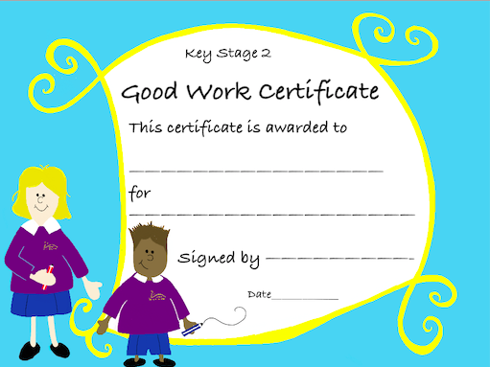
Good Work Certificates
Every week we celebrate our achievements.

Slide 22
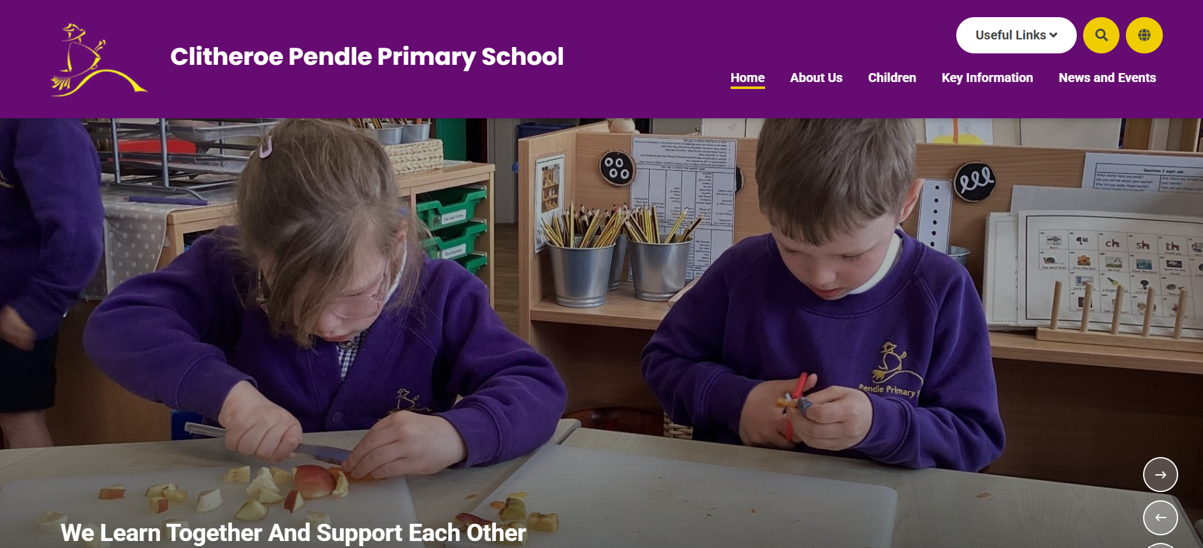
Our Class Page
Visit www.pendle.lancs.sch.uk to find out more!
We are learning to use the new school website. Please use the class pages to find homework, spellings and our weekly blog.

Slide 23
Thank you for your time.

