Slide 1

KS1 Meet the Teacher Evening
Tuesday 15th September 2026
5-5:30pm

Slide 2
Key Stage One Classes
Cherry Class | Holly Class | Horse Chestnut Class | Pine Class
Miss Lancaster (Tuesday afternoon & Weds/Thu/Fri) Mrs Whitwell (Monday all day & Tuesday morning) | Miss Zak Mrs Stansfield (Friday Afternoon) | Miss Markham Mrs Whitwell (All day Thursday & Wednesday morning) Mrs Mercer teaches Y2 Maths | Mrs Kennerley Mrs Stansfield (Monday afternoon)
Miss Clarke | Mrs Birthwistle | Mrs Stansfield Miss Cowperthwaite | Miss Clarke Mrs Taylor
Miss Palmieri also teaches Computing and Forest School for each class. Cherry (Monday morning) Holly (Friday afternoon) Horse Chestnut (Thursday afternoon) Pine (Monday afternoon) Forest School is on a rotation – you will be informed of when to bring wellies and waterproofs in.

Slide 3

Communication
Autumn | Spring | Summer
Parents’ Evening (13th or 14th October) Short Report | Parents’ Evening Short Report | Long Report
Ongoing
Owl Board Topic Newsletter School Website Parent Pay Pick Up & Drop Off
CLASS EMAILS ARE TO BE USED FOR SHARING LEARNING. ANY URGENT MESSAGES SHOULD BE ADDRESSED VIA THE OFFICE OR ON DROP OFF / PICK UP. THEY ARE NOT ALWAYS SEEN ON THE SAME DAY.

Slide 4
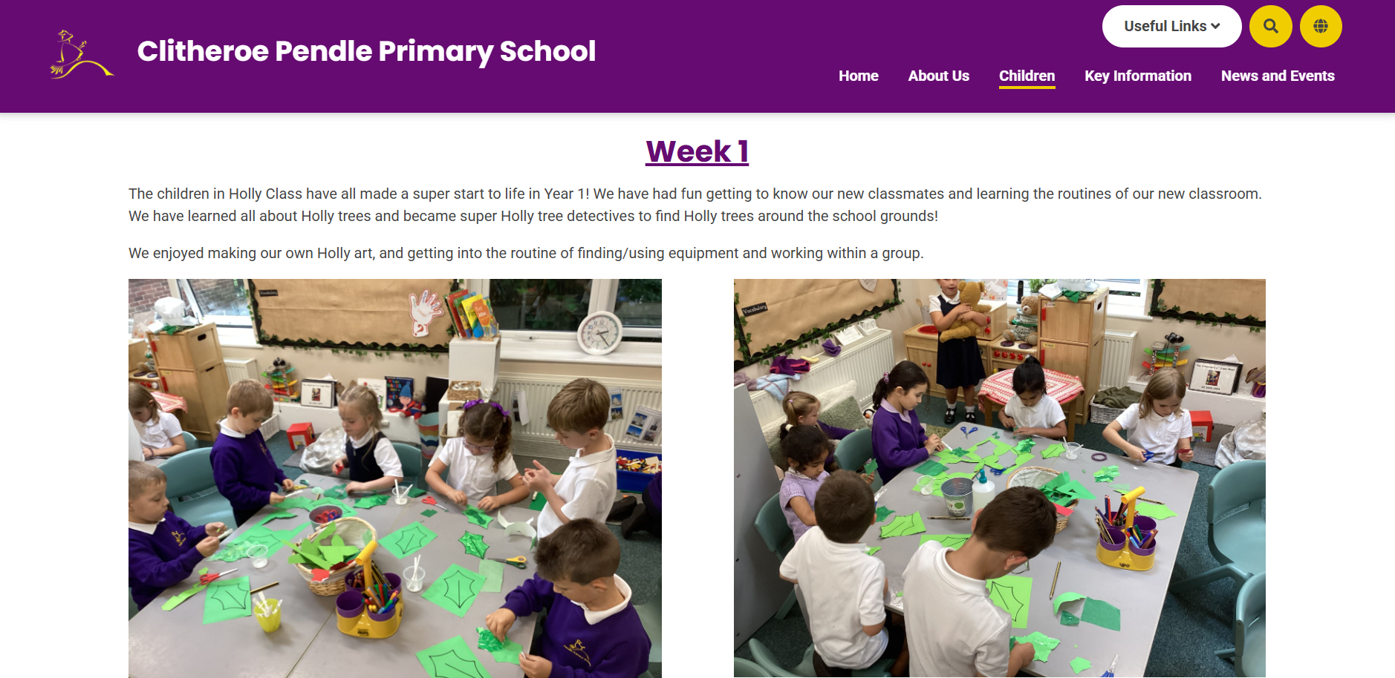
Website
Children -> Class Pages
Blog Style Updates

Slide 5
DSL
In school, we are fortunate to have 6 ‘Designated Safeguarding Leaders’
Mrs Nunns
Mrs Mercer
Mr Morris
Mrs Schofield
Miss Markham
Miss Regan

Slide 6
Online Safety
At Pendle, we take this area of the curriculum very seriously as we have a duty to teach our children to be safe users of technology and the internet. Our children are taught to stay safe online through their weekly Computing sessions and the PSHE curriculum.
Out of school there are a number of websites you, as parents and carers, can use for information and advice:
https://www.childnet.com/parents-and-carers/
https://www.nspcc.org.uk/keeping-children-safe/online-safety/
https://saferinternet.org.uk/guide-and-resource/parents-and-carers
https://www.ceopeducation.co.uk/parents/
https://swgfl.org.uk/audience/parents/
Please be aware the content on these sites is sensitive and adult led. Further information and other leaflets are available in school should you wish to know more.
Thank you
Mrs Schofield

Slide 7

Curriculum
Our curriculum has been carefully planned to ensure a diverse, enriched and exciting learning journey for the children as they progress through school. We take our learning outdoors and out of the school grounds as much as possible!
History, Geography, Art and DT are taught on alternate weeks across a full term. PE, Science, Music, PRSHE units change each term.
Maths, English, Phonics, Guided Reading are taught daily.
Handwriting and NCETM (Mastering Number) are taught 3 times a week.

Slide 8
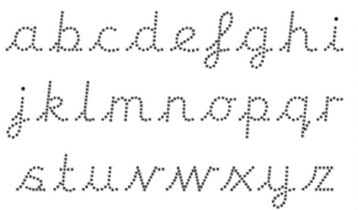
Handwriting
We follow the cursive letter formation. Children begin learning this in Reception. If your child is practising their cursive writing at home, please ensure they are leading into the letters rather than forming the letter and then adding the lead in.

Slide 9



Year 1 Phonics Screening Check

Slide 10
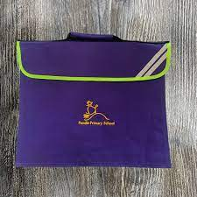

Reading, Reading, Reading!
& Phonics homework

Slide 11
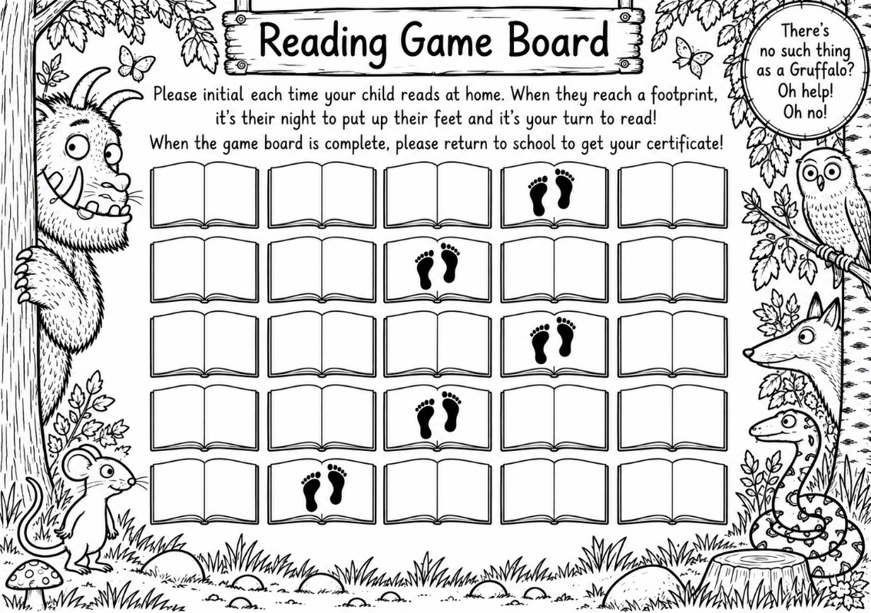
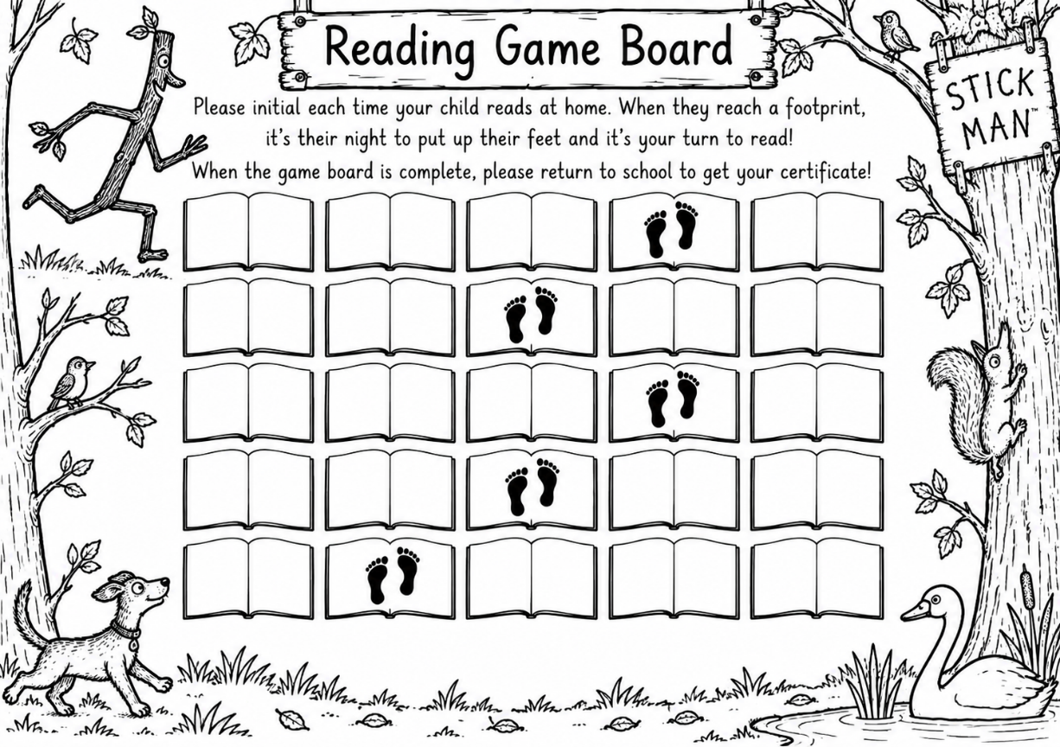
Reading, Reading, Reading!

Slide 12
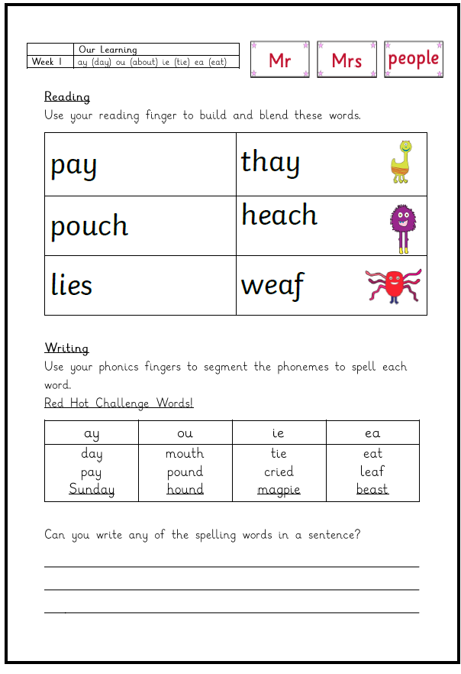
Phonics Homework

Slide 13

Homework
Book Bags Home Daily | Reading Books (Allocated book changing day) | Library Books
Numbots |  | Phonics or Spelling

Slide 14
Behaviour
We have high expectations for children’s behaviour in class, around school and when taking part in visits.
Everybody at Pendle has a right:
To be safe
To fair treatment
To be heard
To be treated with respect
To learn and teach without unnecessary interruption
Our door is always open should you have any behaviour concerns. Again, teamwork makes the dream work!

Slide 15
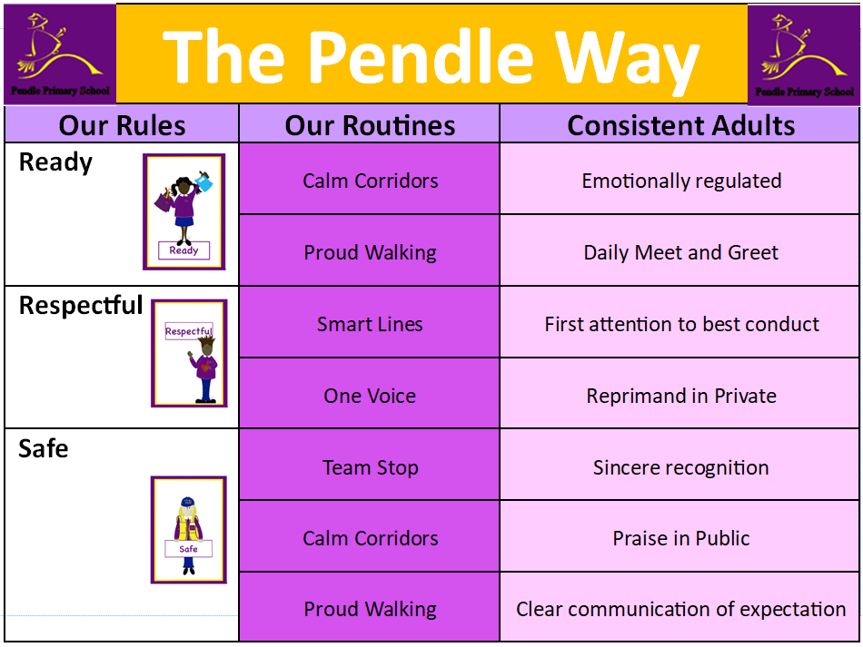

Slide 16
Mental Health and PRSHE
PRSHE Curriculum
Assemblies
Theme days (Anti-bullying week etc).
RHE policy on website (Relationship and Health Education)

Slide 17
Uniform Reminders
Please make sure that ALL uniform is clearly named. (Please!)
No jewellery including earrings and watches.
Hair tied up. (Simple headbands)
No nail varnish.

Slide 18
Organisation Reminders
Children need to bring water bottles to school each day as part of promoting a healthy and active lifestyle.
Your child will receive a piece of fruit each day so you do not need to provide your child with any.
Please do not allow your child to bring a toy to school as the children are provided with equipment and activities to occupy them at playtimes.
Please ensure that your child has a FULL, named PE kit in school for each half term. The outdoor PE kit is in addition not instead of the indoor PE kit.
No Earrings!!!

Slide 19
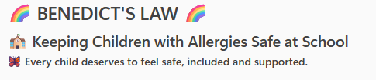
New national allergy safety requirements, known as Benedict's Law, came into effect from September 2026. These requirements strengthen the arrangements schools must have in place to support children with allergies and asthma and to ensure that appropriate emergency medication is readily available when required.

Slide 20
What schools need to do:
Write an Allergy Policy
Appoint a Senior Allergy Lead
Create Individual Healthcare Plans where needed
Keep emergency medication readily available
Take steps to reduce allergy risks during lessons, lunchtimes, clubs, trips and residential visits
Learn from any incidents or near misses to continually improve our procedures.

Slide 21
How parents can help:
Tell us about your child’s allergies . Inform the office so that our records are up to date
Provide up to date medication – 2 x inhalers and auto-injectors in school
Share allergy action plans
Inform us of any changes
Work with us to keep your child safe

Slide 22
Thank You for your support!

