Slide 1

Welcome to UKS2 Meet the teacher information session

Slide 2

UKS2 Team
Teachers
Mrs Atkinson – Oak Y6
Mrs Worsley – Elm Y5
Mr Priory – Sycamore Y5&6
Mrs Mercer (PPA Cover in all classes)
Mr Morris – Year 5 from Sycamore maths daily
Classroom Support
Mrs Thomas
Mrs Howarth
Mrs Musgrave
Mrs Whitehead
Mrs Palmieri (Computing)

Slide 3

Communication
You are always welcome to discuss any concerns you may have.
We are more than happy for you to catch us at the end of the day or
feel free to pop into the school office or ring to arrange a meeting.
Please do not use the home learning emails for general communication and concerns – they are not checked regularly and should only be used for homework submissions.
Parents Evenings are scheduled for the end of Autumn 1 (13th and 14th October 2026) and Spring (23rd and 24th March) .
Details about how to book will be sent out on ParentPay prior to these.

Slide 4
Communication
Fortnightly school newsletters
Topic letters
Class pages
Parent Pay – please check regularly for letters (Dinner money, trips, consent)

Slide 5
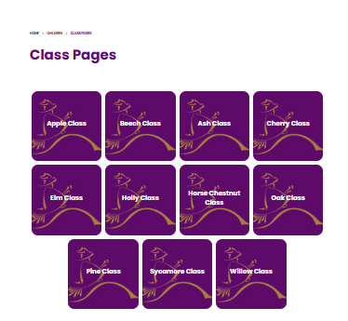
School Website
There is a lot of information on the school website about what is going on in each class. There is a designated page for every class which will be updated regularly for you to get a taste of the exciting activities your child has been engaged in.
www.pendle.lancs.sch.uk

Slide 6

Designated Safeguarding Leads
In school, we have ‘Designated Safeguarding Leaders’:
Mrs Wendy Nunns (Headteacher)
Mr Morris (Deputy Headteacher)
Mrs Debbie Mercer (Assistant Headteacher)
Miss Kate Markham
Mrs Jo Schofield
Nicola Regan (TWIGS)
If you have any serious issues or concerns that you feel that the school should be made aware of, please contact any of the above.

Slide 7
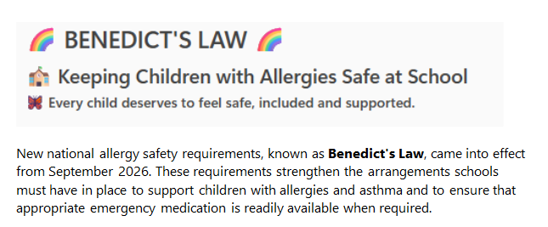

Slide 8
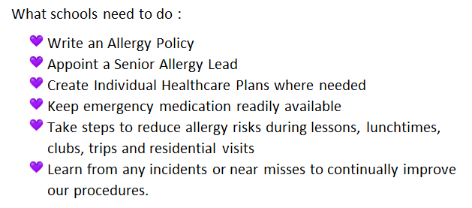
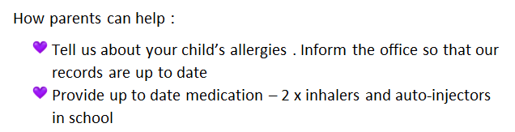


Slide 9

Mental Health and Wellbeing
Addressed though:
Assemblies
PSHE with RHE lessons, including class discussion and theme days
TA support
ELSA support
Freeflow Counselling

Slide 10
Equipment Needed
Coats to be brought daily – this is Clitheroe!!!
ALL clothing must be named!
Reading Books and Records returned to school daily
Reading book bags – must be used
Large rucksacks and stationery equipment should not be brought in.
Water bottles to be brought daily as part of promoting a healthy and active lifestyle, in addition to packed lunch drinks.
We encourage the children to bring a healthy snack to eat at break-time – fruit or vegetables only.

Slide 11


Equipment Needed
Please ensure that your child has a FULL, named PE kit in school for each half term. We have introduced a navy tracksuit which can be worn for PE outside – this is in additional to the normal kit.
(kits can be left on pegs, they will be sent home for washing at the end of each half term)
Reading book bags
Please note: children should not bring their own pencil cases/notepads etc, these cause problems with them getting lost/mixed up etc.
If a child requires the use of a ‘fidget’ as detailed on their POP, these are supplied by school.

Slide 12


Curriculum
English - Daily
Guided reading – Daily
Maths – Daily
Science – 2 hours a week
Topic
Topic letter half termly to inform you of coverage

Slide 13


School Values

Slide 14
Feedback
Feedback within lessons to impact on children’s understanding and progress.
Issues will be addressed as they arise and necessary support provided.
There will be less marking in books as verbal feedback will be given..

Slide 15
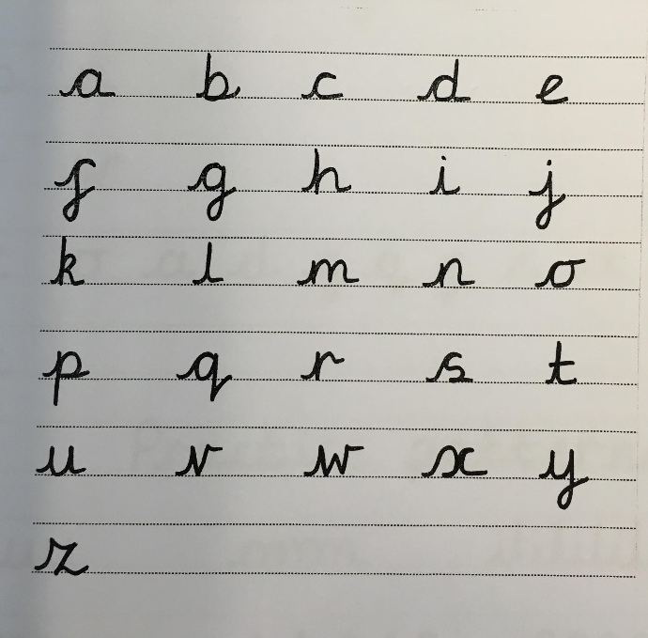
Handwriting
There is the school policy which is adopting cursive handwriting from Early Years through to Year 6.
There are three basic rules to follow:
All capital letters stand alone and do not join to other letters.
All lower case letters start on the line and begin and end with a small flick.
The pen flows to the end of the word and only then do the children return to dot the ‘i’ and cross the ‘t’.

Slide 16


Homework
Home reading books
Children should bring their home reading book to school every day. They should be reading for at least 15 minutes every night. Children are responsible for their books and once completed, they are encouraged to independently change them.
One sentence summaries, adult to sign weekly
TTRockstars
Weekly multiplication homework will be set in the form of timetable rockstars (link to website on class pages) – all children have a log on and are expected to complete this weekly.
Weekly spellings on class pages to practise at home.
Year 6 – LBQ, SPAG.com, maths.co.uk – set weekly, class pages detail work set

Slide 17
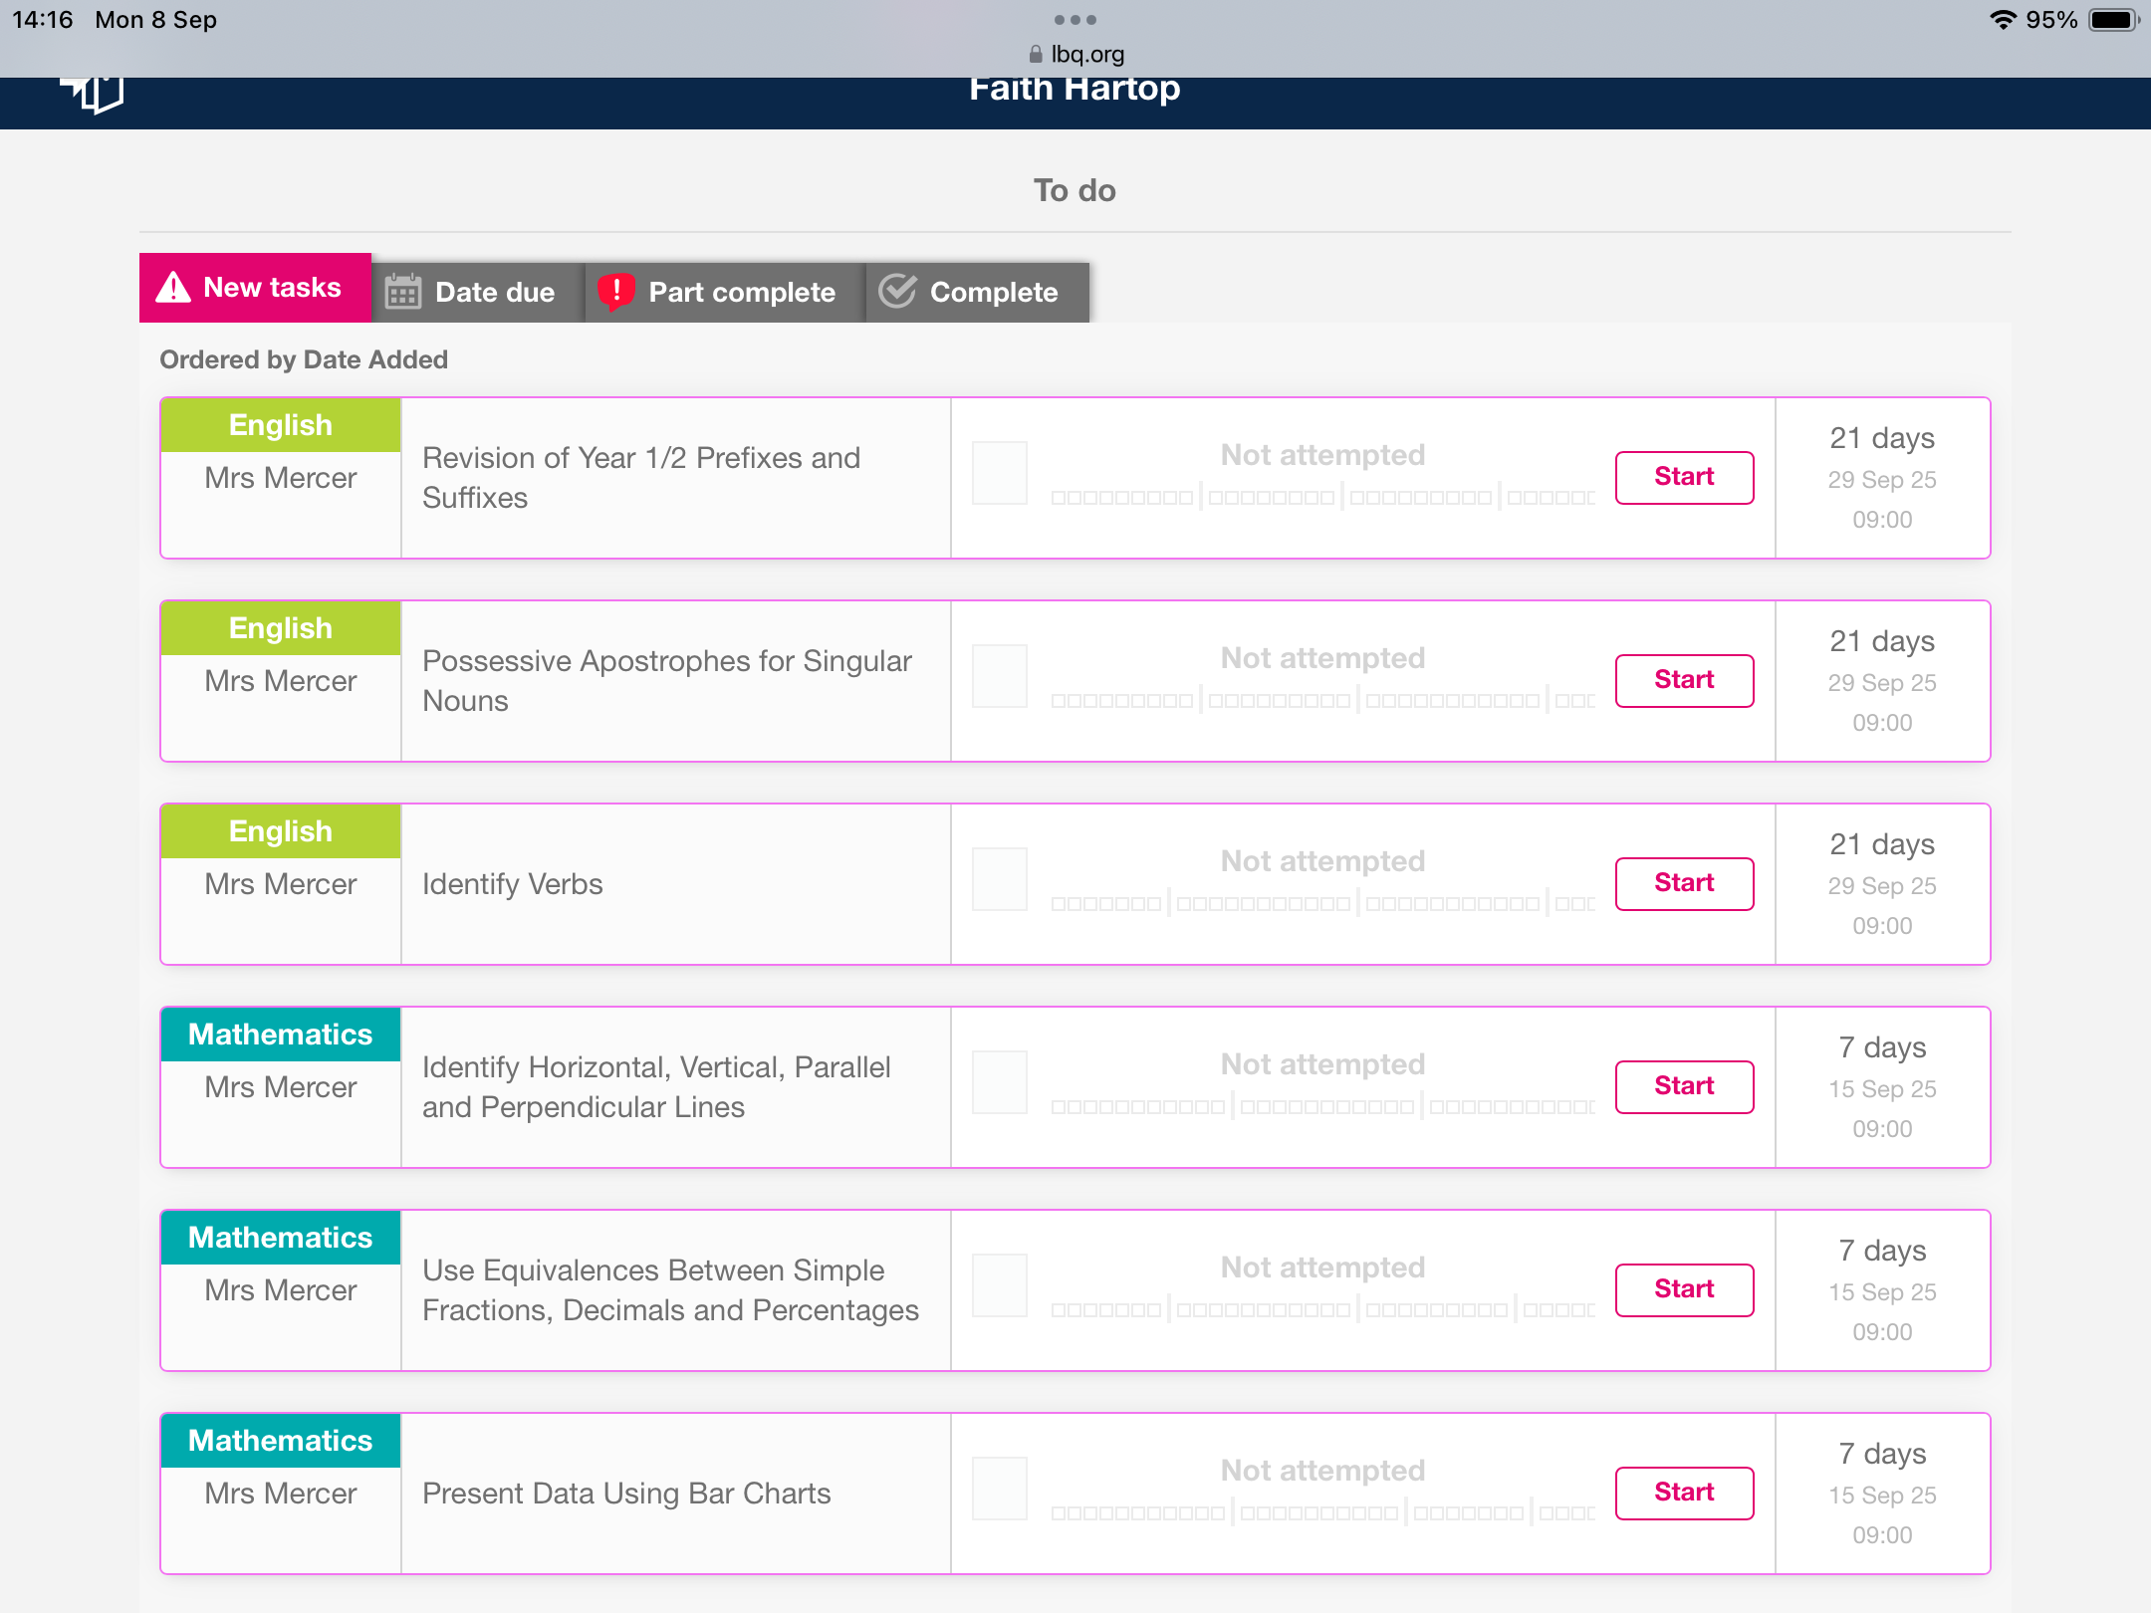
YEAR 6 ONLY – LBQ SPRINGBOARD DASHBOARD
YEAR 6 We will also use LBQ, maths.co.uk and spag.com to support learning.
Individual log-in details are stuck in reading records - a good idea to copy these down and keep them safe at home to log on easily e.g. near PC/ laptop/tablets
https://www.lbq.org/

Slide 18
Project Homework
Additional to this, each half term we are asking parents to work on a project at home with their child.
Homework Submissions
Homework should be brought into school on the date due or can be emailed to:
oak@pendle.lancs.sch.uk
elm@pendle.lancs.sch.uk
sycamore@pendle.lancs.sch.uk
Please Note: this email will only be checked on the hand in date in the final week of each half term, please do not use this for general communication or queries, please telephone school or pop into the school office in this instance.
We CANNOT accept USB sticks in school due to data protection.

Slide 19
Assessment
Assessment weeks will be at the very end of the term.
Reports of progress and attainment will be given out in the last week of each term
If there are any issues/concerns with children please be reassured that you will be contacted straight away.
Year 6 SATs – no pressure, prepared through the year, further parent information session in Spring 1

Slide 20
Behaviour Policy
We take behaviour seriously at school.
Everybody at Pendle has a right:
• To be safe
• To fair treatment
• To be heard
• To be treated with respect
• To learn and teach without unnecessary interruption
We encourage good behaviour in school through clear rules, praise and rewards.
If a child misbehaves they will be reminded of the rules and the choices they can make.
Full details of our Behaviour Policy can be found on the website.
Lunchtime books
.

Slide 21
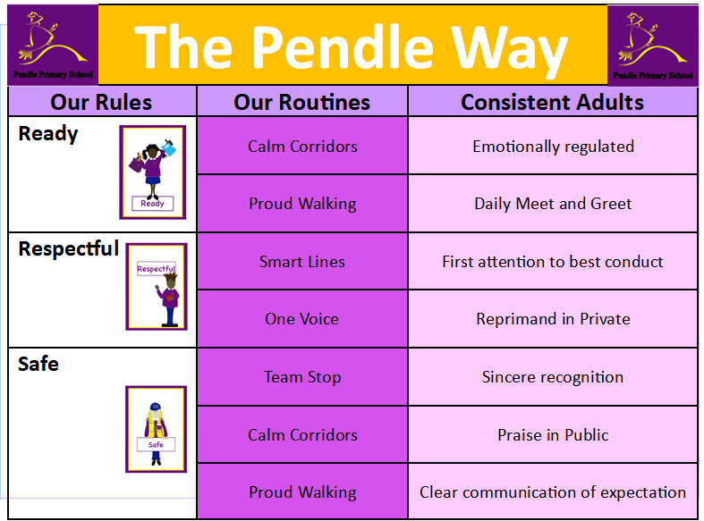

Slide 22
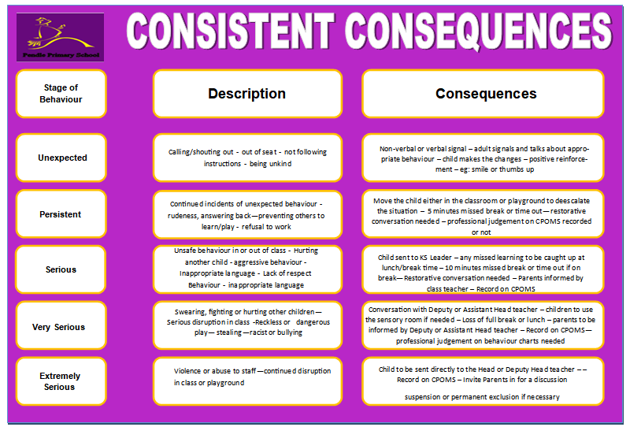

Slide 23
Online Safety 2026
At Pendle, we take this area of the curriculum very seriously as we have a duty to teach our children to be safe users of technology and the internet. Our children are taught to stay safe online through their weekly Computing sessions and the PSHE curriculum.
Out of school there are a number of websites you, as parents and carers, can use for information and advice: https://www.childnet.com/parents-and-carers https://www.nspcc.org.uk/keeping-children-safe/online-safety https://saferinternet.org.uk/guide-and-resource/parents-and-carers https://www.ceopeducation.co.uk/parents https://swgfl.org.uk/audience/parents
Please be aware the content on these sites is sensitive and adult led. Further information and other leaflets are available in school should you wish to know more.
Thank you

Slide 24

As children in Years 5 and 6 become increasingly independent and begin using mobile phones and social media platforms, it’s more important than ever that we work together to ensure their online experiences are safe, respectful, and age-appropriate.
We are seeing a growing number of pupils using apps such as WhatsApp, Snapchat, and TikTok, many of which have age restrictions of 13+. These platforms can expose children to risks such as inappropriate content, cyberbullying, and contact with strangers. Even within group chats, children may encounter peer pressure, exclusion, or upsetting messages.
We kindly ask all parents to:
Monitor your child’s phone use regularly, including messages, apps, and screen time.
Discuss online safety with your child, including how to respond to inappropriate content or behaviour.
Ensure privacy settings are enabled on all apps and devices.
Remind children not to share personal information or photos online.
Encourage open communication so they feel comfortable coming to you or a trusted adult if something worries them.

Slide 25
Reminders
Uniform to be named
No jewellery including earrings
Hair to be tied up
Toys and valuable items to be left at home
Phones are not to be brought into school unless it is essential and must be kept in the office.
Black school shoes (not trainers) must be worn in school, unless doing PE.
Water bottles to be brought daily, water only, no squash or juice (in addition to packed lunch drinks).

Slide 26
Thank you for your time

