Slide 1
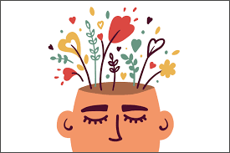
Clitheroe Pendle Primary wellbeing warriors

Slide 2

What do we do?
We were chosen by our teachers to be outstanding role models around school and to help other children by listening to problems and helping to restore friendships when people have a falling out. We also lead games for children who might not have anyone to play with and try to ensure that everyone is happy in school. You will recognise us by purple caps with a ‘W’ letter on (soon to arrive).
Our role is to:
Be a positive role model
Promote a healthy lifestyle
Promote the 5 ways to wellbeing
Reduce the stigma around mental health amongst their peers
Encourage children to talk and share
Be someone that can listen, support people and ask for help.

Slide 3
We will help you by
Listening to you
Helping you to find a solution to a problem
making sure you have someone to play with
Helping you understand how to be a kind friend.
We are going to learn how to use restorative questions to:
talk about conflict calmly
listen to each person’s point of view
recognise the emotions felt during the conflict
help everyone involved decide on a way to repair any harm caused
These questions are:
What happened
What were you thinking when it happened?
How are you now?
What do you need to feel better?
What needs to happen to put things right?

Slide 4

We will be on the playgrounds to help anyone who seems lonely, sad or who is having a friendship difficulty.
How will you recognise us?
We will be on the KS1 and KS2 playgrounds.
We will be wearing purple caps so that we are easy to spot!
We will work in pairs and there will be different children on duty each day.
Our photos will be displayed around the school so that you can find us if you want to talk to us.
What we will do……….
If we notice anyone who looks sad or lonely we will ask if we can help them or invite them to join our game.
If anyone has a problem which has made them feel angry or upset, we will help you to have a restorative chat to try to resolve the situation.

Slide 5


Slide 6
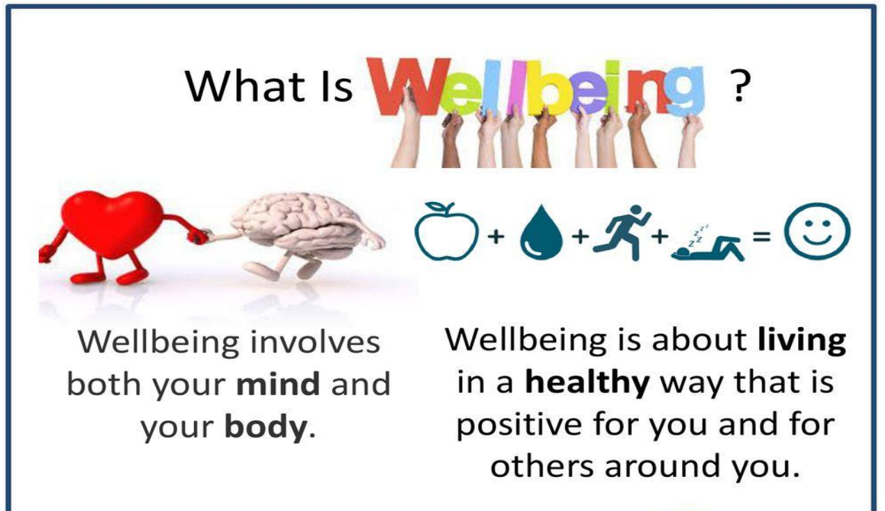

Slide 7
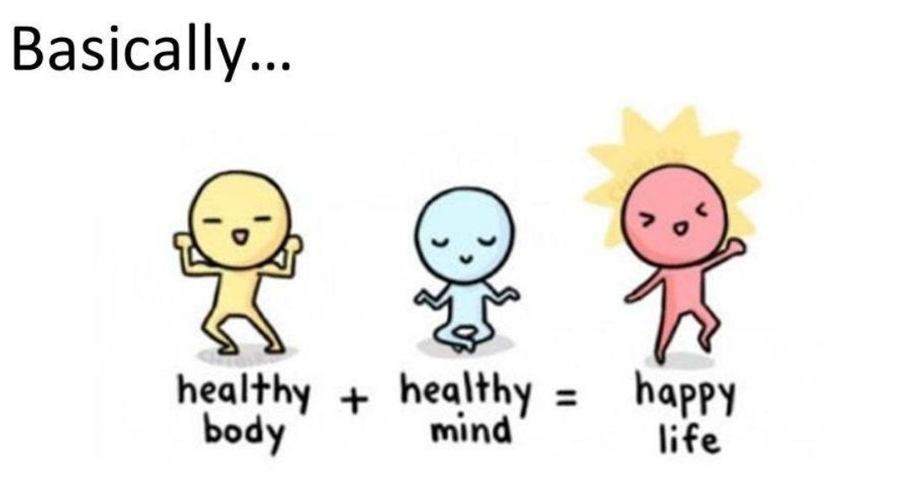

Slide 8


Slide 9


Slide 10
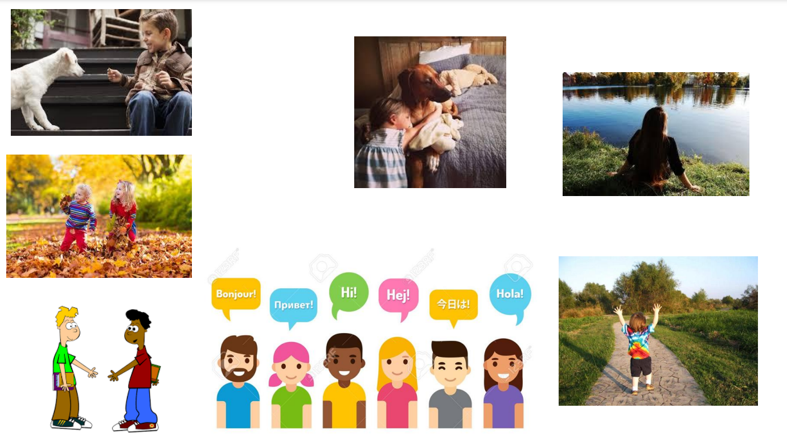

Slide 11
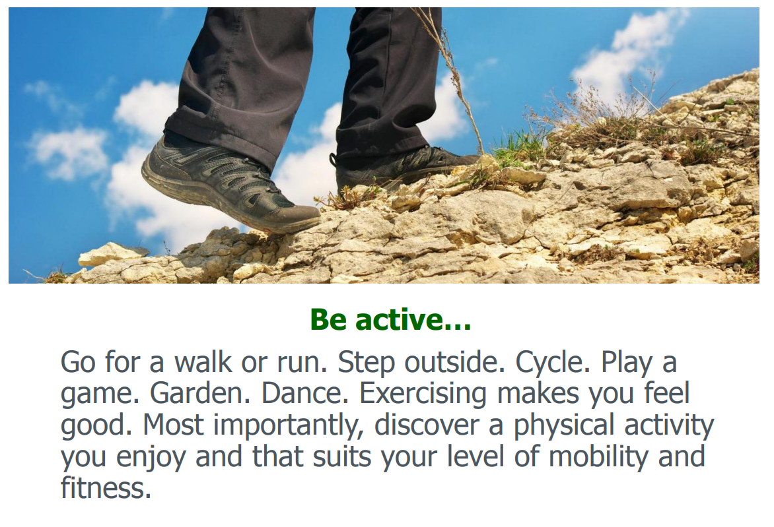

Slide 12
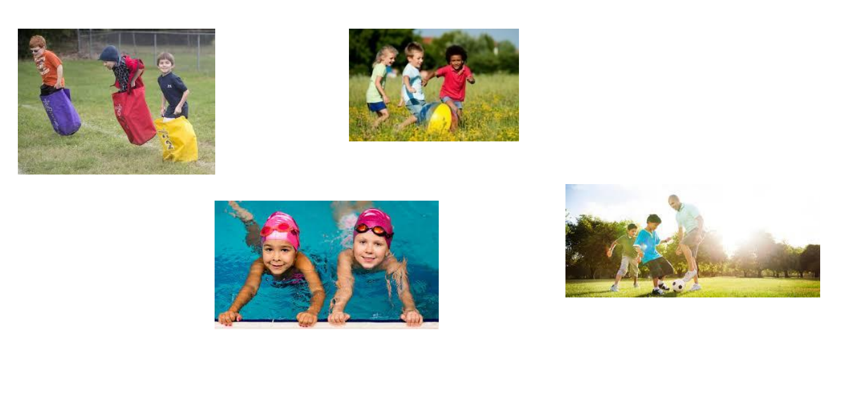

Slide 13
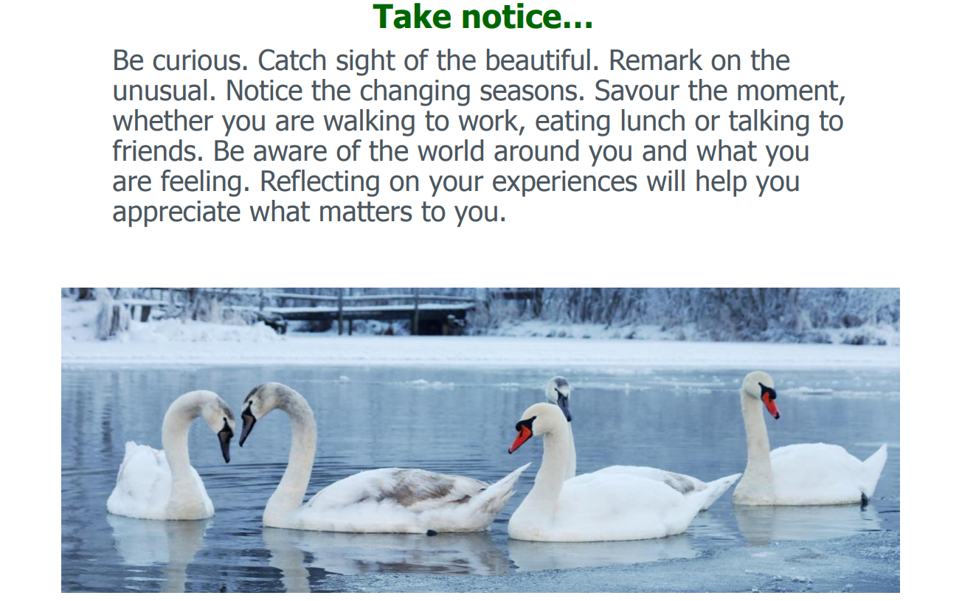

Slide 14
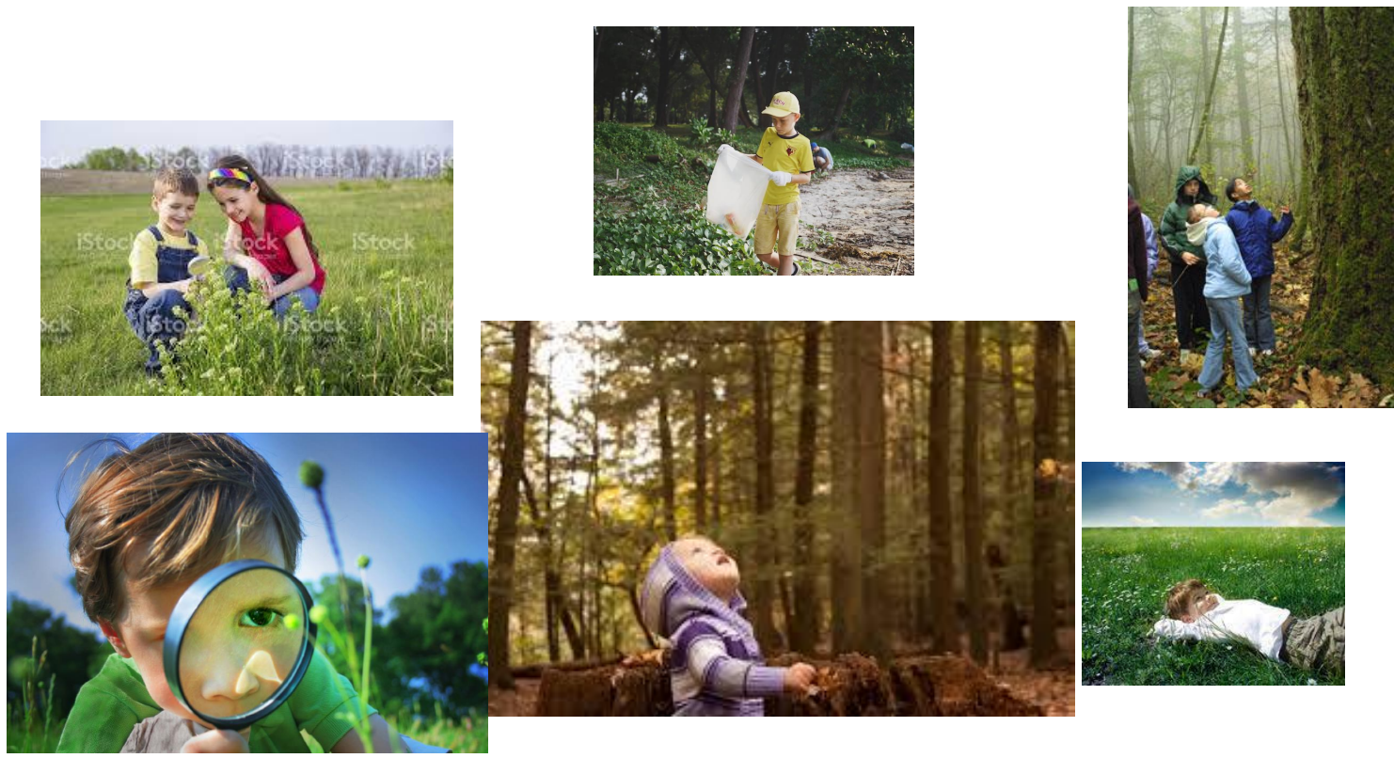

Slide 15
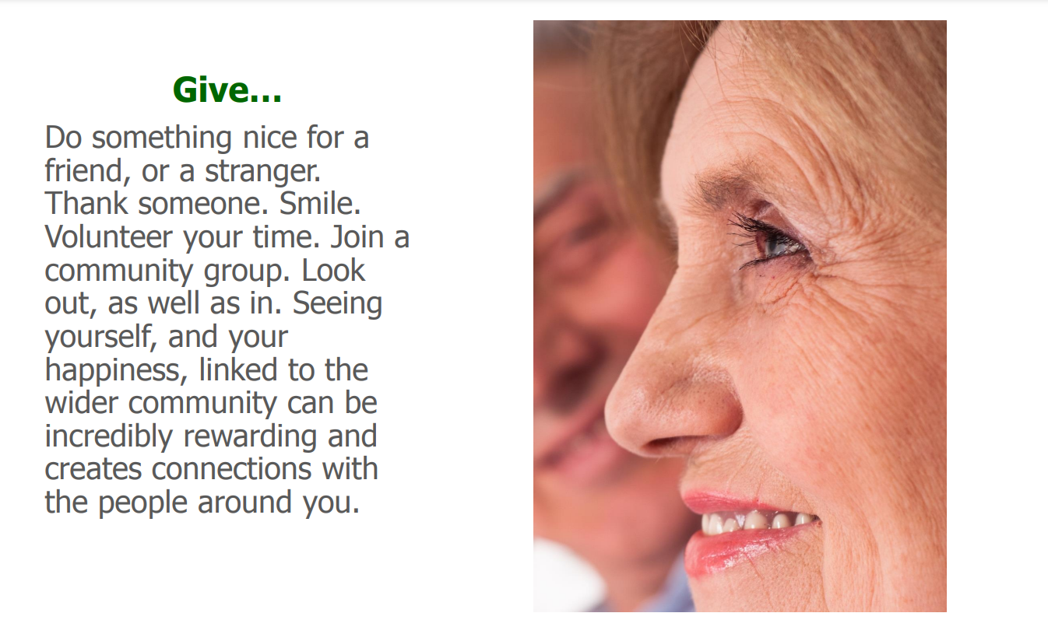

Slide 16
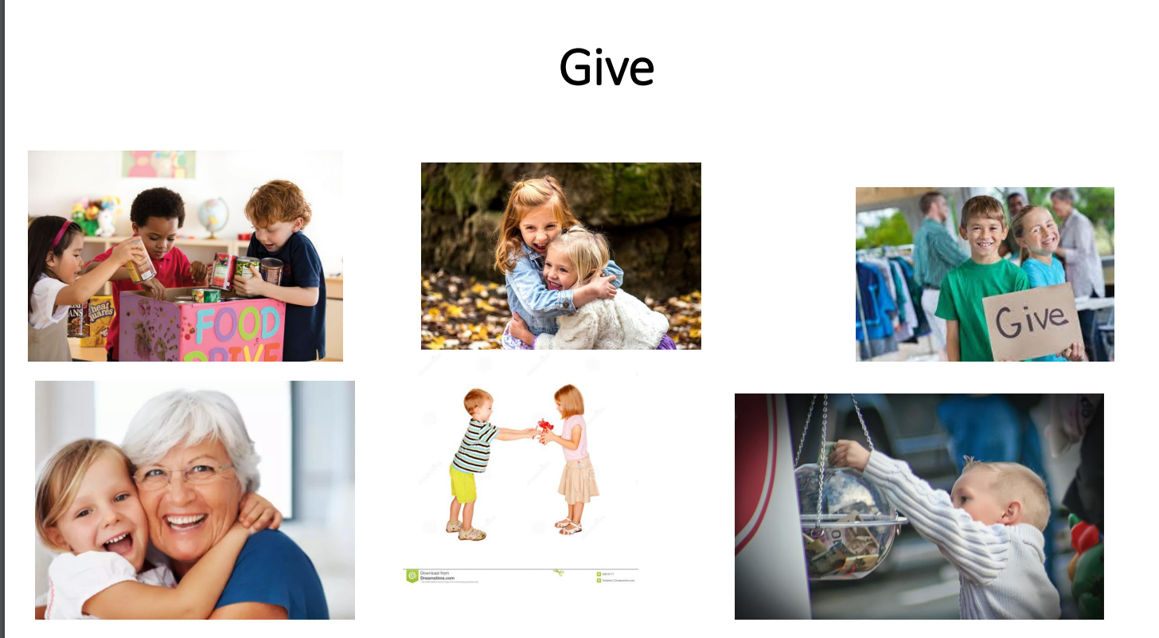

Slide 17
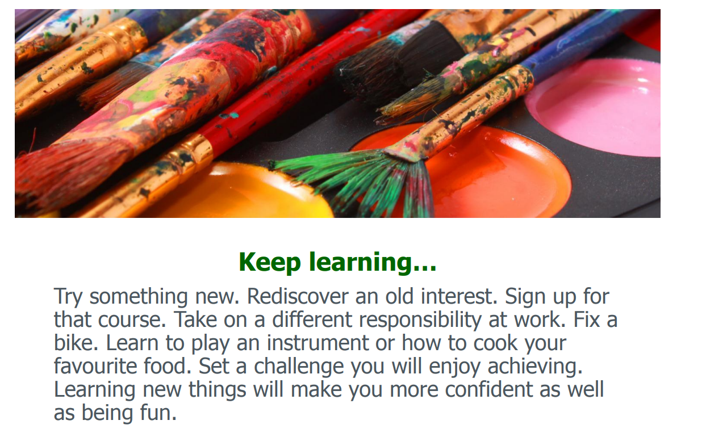

Slide 18
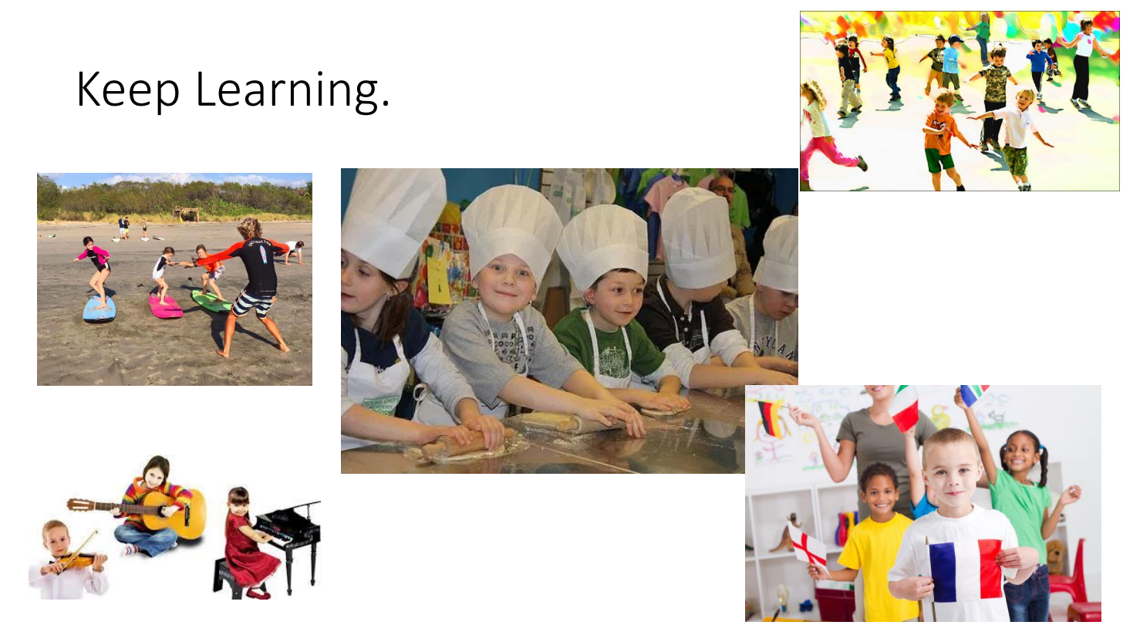

Slide 19
https://www.youtube.com/watch?v=x6bz_ekkrYA

Slide 20
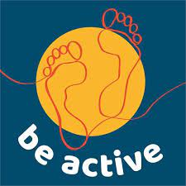

Last half term:
We helped you with strategies to ‘Take Notice’ – relax and meditate with breathing techniques.
These can be found on the school website for you to have a go at in class or at home.
This half term:
We will be focussing on ‘Be Active’
We are setting up a fitness trail around the playgrounds.
This links with the school council’s ‘ Walk to School’ campaign.

