Slide 1

SaTs 2024 information for parents and carers

Slide 2
We hope to :
Provide you with important information
Answer your questions
Ease any worries you may have

Slide 3
We have put a selection of past SATs papers out on the tables at the back , please feel free to have a look at the end of the talk.
Please could we ask that you don’t take any away with you.
They are available freely at gov.uk.
We do use past papers in class and for assessment therefore we do ask that you please don’t give your child the papers to work through at home.

Slide 4
What are the SATS tests?
The end of KS2 assessments are sometimes informally referred to as ‘SATS’.
SATS week across the country begins on Monday 13th May to Thursday 16th May 2024
Pupils will complete test papers in some of the areas that have to be assessed. Other areas, like writing, are assessed using evidence collected by the teacher over a longer period of time.
Pupils will complete SATS test papers in:
- Reading
- Grammar, Punctuation & Vocabulary
- Spelling
- Arithmetic
- Mathematical Reasoning – 2 papers

Slide 5
Date | Exam
Monday 13th May 2024 | Spelling, Punctuation & Grammar - Paper 1 (45mins) Spelling, Punctuation & Grammar - Paper 2 (15-20mins)
Tuesday 14th May 2024 | English Reading (60mins)
Wednesday 15th May 2024 | Maths Paper 1 (Arithmetic) (30mins) Maths Paper 2 (Reasoning) (40mins)
Thursday 16th May 2024 | Maths Paper 3 (Reasoning) (40mins)
The tests all take place in normal school time, under test conditions.
Pupils will not be allowed to talk to each other during the tests.
The completed papers are sent away to be marked externally.
Results are returned to school in July.

Slide 6
The tests vary in length but last no longer than 60 minutes:
- Reading: 60 minutes
- Grammar, Punctuation & Vocabulary: 45 minutes
- Spelling: 15 minutes
- Arithmetic: 30 minutes
- Mathematical Reasoning: 2 papers of 40 minutes each.
SPaG - 45 mins written test . 45 mins to answer short questions and
- separate spelling test- 20 words
English reading booklet – comprehension. Includes a mix of 3 genres which increase in difficulty. Children have 1 hour to read and complete the booklet.
Maths – Paper 1 – Arithmetic – 30 mins
- Paper 2 – Reasoning – 40 mins
- Paper 3 – Reasoning – 40 mins
Science – Teacher assessment

Slide 7
Scaled Scores
Scaled scores are used to report National Curriculum test outcomes.
Scaled scores are based on raw scores. A scaled score of 100 represents the expected standard
How are the tests graded?
The marked tests will provide the following information:
- A raw score (i.e. number of marks)
- A scaled score (see below)
- An indication of whether the national standard has been met.
In scaled scores, a score of 100 represents the national standard. The lowest is 80 and the highest is 120.
After each test is marked, it will be converted into a scaled score and that will show whether a pupil is working at the national standard, or above or below it.
A pupil will need to achieve a scaled score of 100 to show that they have met the national standard on the test.
There are no longer separate tests for higher attaining pupils, but they might expect a scaled score of closer to 120 which would indicate the pupil is working above the expected standard.

Slide 8
Results
All results come back in July
Secondary Schools also are given SATs results and Teacher Assessments
We will give the children their SATs results and allow time to discuss how they feel about their results, a copy of their results will also be sent home with their end of year report.

Slide 9
Targets
Children’s targets are based on their Key Stage 1 assessment scores
National Expectation in Y2 = National Expectation in Y6 = Expected standard
Children who achieved above expected at KS1 – target = Greater depth or higher standard ( 110 or above)

Slide 10
The Reading Test
The test assesses whether pupils’ comprehension of age appropriate texts meets the national standard. There will be numerous questions on inference, vocabulary and authorial choice.
Pupils will have 60 minutes to complete the test, including reading the texts and writing the answers.
The test will have three different texts to read, drawing on fiction, non-fiction or poetry.
Questions are focused around the following areas (called ‘content domains’):
- give/explain the meaning of words in context
- retrieve and record information/identify key details from fiction and non-fiction
- summarise main ideas from more than one paragraph
- make inferences from the text/explain and justify inferences with evidence from the text
- predict what might happen from details stated and implied
- identify/explain how information/narrative content is related and contributes to
meaning as a whole
- identify/explain how meaning is enhanced through choice of words and phrases
- make comparisons within the text
There are a range of answer types, including multiple choice, short one-word answers and longer answers that require a written paragraph.

Slide 11
Reading
English Reading 60mins, 3 texts with questions about each
3 pieces to read. Children do struggle to complete pieces in time.
Sustained reading is essential!!!!
Keeping the pace!

Slide 12

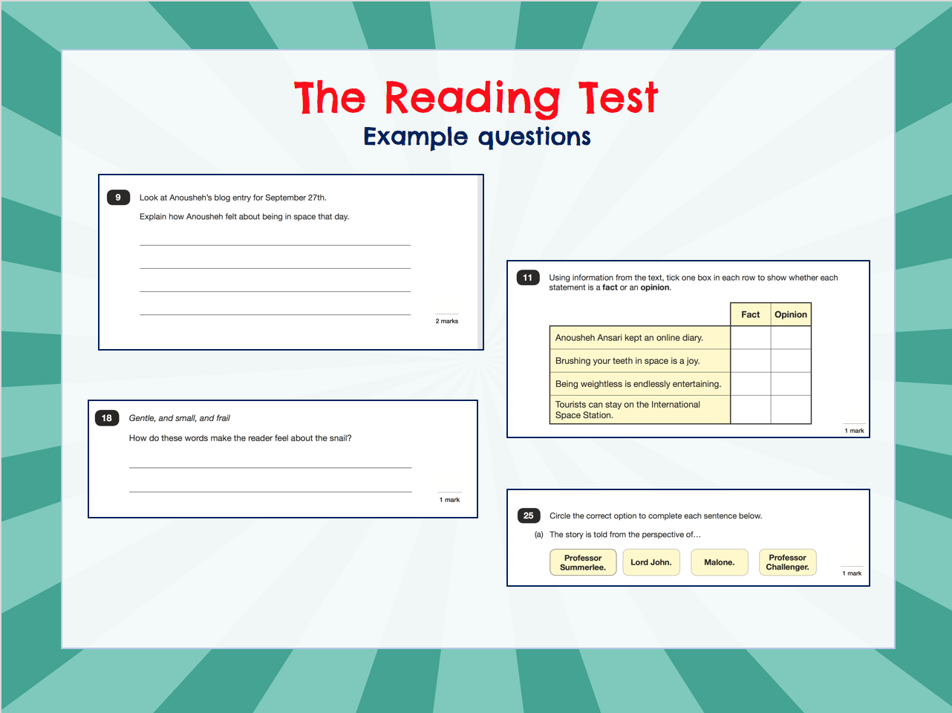

Slide 13
The SPaG Tests
There are two tests: a short spelling test and a longer paper testing grammar, punctuation and vocabulary.
The spelling test lasts approximately 15 minutes and pupils will need to spell words in context by filling in the gaps in sentences.
The grammar, punctuation and vocabulary test lasts for 45 minutes.
Pupils need a good working knowledge of technical vocabulary used to describe grammatical terms and punctuation marks.
Questions in the grammar test are focused around the following areas (called ‘content domains’):
- Grammatical terms/word classes
- Functions of sentences
- Combining words, phrases and clauses
- Verb forms, tenses and consistency
- Punctuation
- Vocabulary
- Standard English and formality
There are a range of answer types in the grammar test, including multiple choice and short one-word answers, but there will not be any long written answers required

Slide 14
SPaG
45 Minute Test – Paper 1
Variety of questions about punctuation, grammar, word meaning and word choices (50 marks)
Paper 2 - Separate spelling test, spellings read out by an adult (20 marks)
Combined score of both papers
Knowledge of grammatical terminology = key

Slide 15
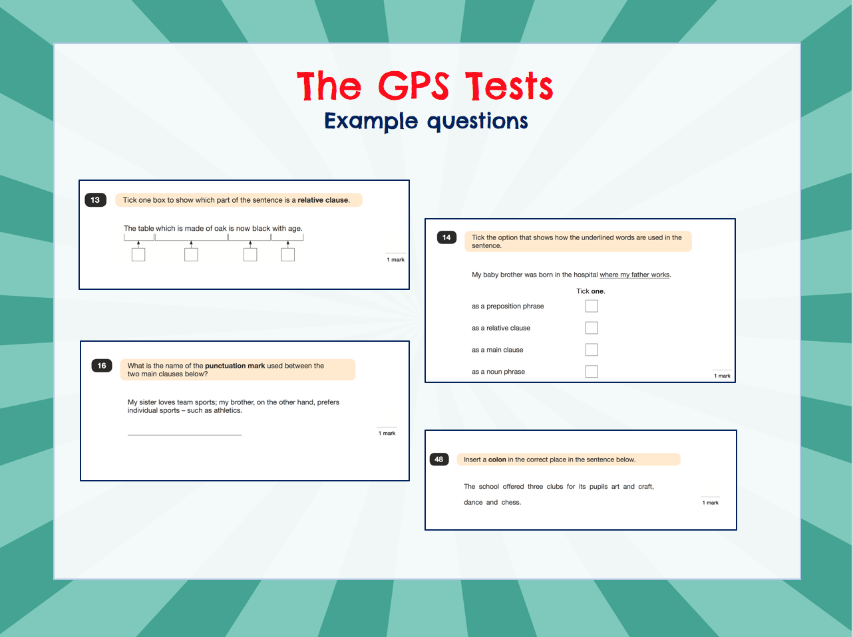

Slide 16
The Maths Tests
There are three tests: one arithmetic paper and two reasoning papers.
Paper 1 (arithmetic) lasts 30 minutes and assesses pupils’ confidence using methods of calculation as well as fractions, decimals and percentages. It covers curriculum content from all of KS2.
Papers 2 & 3 (reasoning) last 40 minutes each and focus on problem solving, fluency and applying mathematical reasoning.
Questions cover the following areas (called ‘content domains’):
- Number and place value
- Addition, subtraction, multiplication and division (calculations)
- Geometry – properties of shapes
- Geometry – position and direction
- Statistics
- Measurement
- Algebra
- Ratio and proportion
- Fractions, decimals and percentages.
Questions will increase in difficulty as the paper progresses and not all children will complete the papers.

Slide 17
Maths
Maths – 57/110 marks = EXS
- 95/110 = Greater depth
3 papers – Arithmetic (40 marks)
- 2 Reasoning ( 35 marks each)
Large emphasis on reasoning
Children need to READ THE QUESTIONS CAREFULLY!

Slide 18
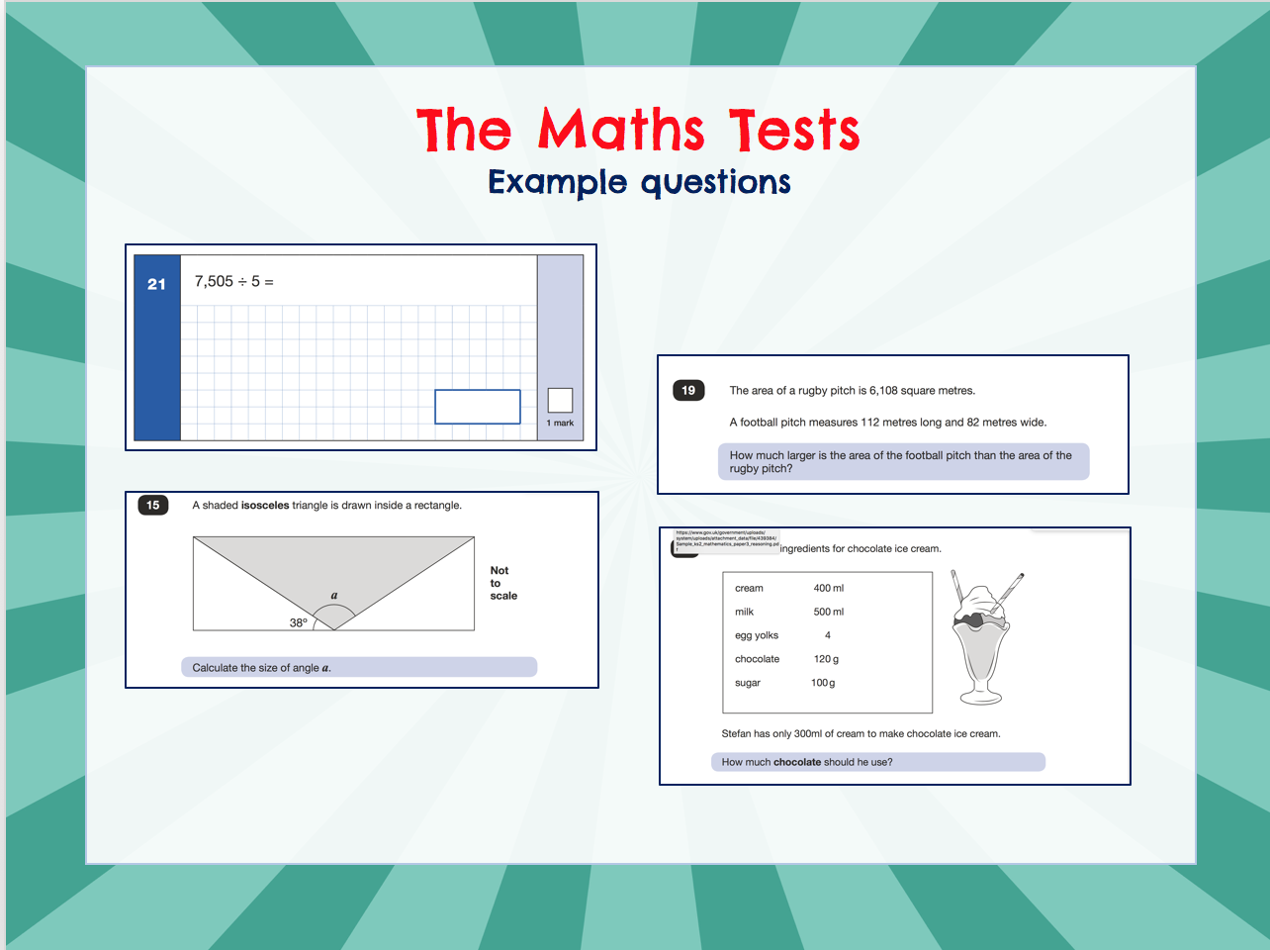
©Ks2history 2018

Slide 19
Writing
A judgement is made on 10-15 pieces of writing completed throughout the year plus the quality of written work across the children’s class books.
The children have to be consistently achieving the level to be awarded it.
The assessments are moderated by the LEA.

Slide 20
Science
Mrs Mercer teaches science in Year 6, she, along with Mrs Atkinson and Mrs Wardle will assess progress in Science and make a judgement based on children’s work throughout the year. They will assess whether they are working at the expected standard or not.

Slide 21
Organisation
Tests can be administered in a variety of ways to provide your child with the necessary support they need :
In small groups
Providing a reader
Transcribing work that is difficult to read.
Providing a scribe
Providing extra time – you will be notified if your child meets this criteria.
We have a breakfast club for 8.30am for Year 6 children during SATs week with bacon or sausage butties on the final Thursday.

Slide 22
Illness/absence
Please try your hardest to avoid any absence during test week.
If children are ill please report to school as early as possible.
Children who are absent may take tests up to a week later but must not be in contact with any other children. S/he would have to be brought into school and isolated from their peers.

Slide 23
How can I help at home?
Any homework set needs to be completed on time and shared with parents.
Encourage high quality and 100% effort
Discuss any mistakes or areas your child is struggling with
Sign the homework to show you have shared it with your child
Please add any comments to show if your child had any difficulties or required help with any aspects

Slide 24
How can I help at home?
Booster classes for invited children take place before school and attendance is encouraged
Maths and SPAG revision sites have been provided. They will be used in class, in revision sessions and as homework – more info about these next…
Practise spellings – patterns and rules
Practise multiplication tables
Early nights.
Reading at home is vital! 2x per week and diary signed

Slide 25
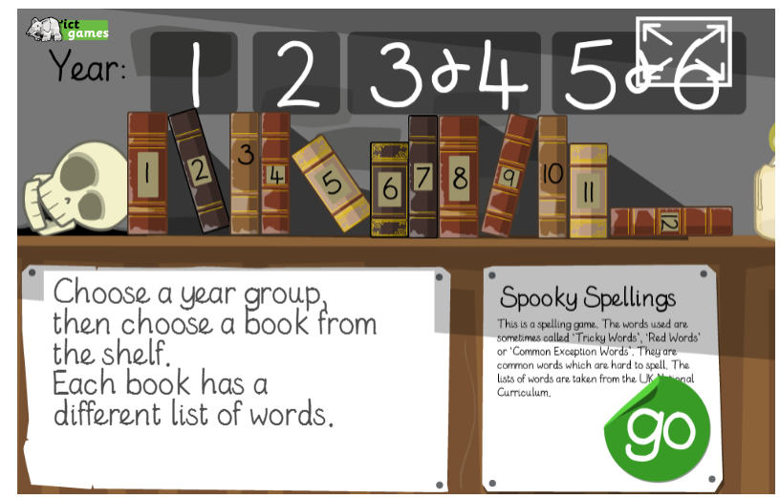



Revision help at home:
https://www.topmarks.co.uk/english-games/7-11-years/spelling-and-grammar
https://ictgames.com/mobilePage/spookySpellings/index.html
https://spellingframe.co.uk/
www.spag.com
www.maths.co.uk
Year 6 children are set a question set for revision for SPAG and Maths every Friday, to be completed for the following Friday. Teachers are able to see results, analyse progress and target support where neededl. Question sets are chosen to support areas of revision and understanding to ensure that the children are fully prepared.

Slide 26

Wellbeing
Why is Year 6 wellbeing for SATs important?
It is widely understood that positive health and wellbeing – including mental health – contribute to a child’s ability to flourish, thrive and achieve (Public Health England, 2014), and equipping children with the skills to enhance their resilience against adversity will enable them to navigate challenges without compromising performance. The phrase “Key Stage 2 SATs” can be a trigger for stress in teachers, parents and children all over the country. Opinion is divided over these National Assessments but it is still vital that Year 6 pupils are able to navigate SATs season without experiencing undue stress or anxiety.

Slide 27
Wellbeing
How will we support your child?
The language we use to communicate with children about SATs can have a powerful impact on how they’re later approached.
The concept of ‘pass’ or ‘fail’ for Year 6s is quite hard to digest and communicates that there are only two possible outcomes. No child likes to fail, and having a fear of failure may actually discourage them from engaging, rather than inspiring them to work hard to do well.
We emphasise that everyone will get different results, as it’s an individual experience.
We encourage all our children to work hard to achieve their own individual potential – whatever that might look like.
We talk about SATs as assessments to see how much has been learnt at primary school – this also takes away the emphasis that it’s only Year 6 input that counts.
We talk them through techniques for mindfulness – breathing exercises, mindful colouring, break breaks, Imoves, skipping, using our senses to refocus, encourage good habits with sleep, diet and exercise (information on how you can support this at home can be found on our school website).

Slide 28
SATS Week…
We make the weekend before SATs a homework/revision free time. We encourage the children to rest and have fun!
We offer a free breakfast club Mon- Thurs – helps the Year 6s feel special, we can talk to the children about any worries and reassure them.
We provide down time after a paper that could include something
physical (usually outdoors) so the children can work off energy, be loud and let
off steam.
We spend some time in the afternoon recapping for the next day, this reassures children that they are ready and prepared.
Offer praise and encouragement at every opportunity – children love to hear
that you are proud of them.
Finally…we celebrate their hard work and effort with a special treat once the tests are all finish.
Many Year 6’s in previous years have described SATs week as the best week in school ever!

Slide 29
Finally
Please don’t panic!
Encourage your child to give 100%
Encourage your child to relax after they have completed homework
They will be fully prepared by May!
Any questions at anytime - please don’t hesitate to come and see a member of staff

